Slide 1
Introduction to Operating Systems

Slide 2
An Operating System?
What is an Operating System?
A program that acts as an intermediary between a user of a computer and the computer hardware.
What is the purpose of an operating system?
To provide an environment in which a user can execute programs.
What are the goals of an Operating System?
The primary goal of an Operating System is to make the computer system convenient to use.
The secondary goal is to make the computer system efficient to use.

Slide 3
Computer System Components
Hardware – provides basic computing resources (CPU, memory, I/O devices).
Operating system – controls and coordinates the use of the hardware among the various application programs for the various users.
Applications programs – define the ways in which the system resources are used to solve the computing problems of the users (compilers, database systems, video games, business programs).
Users (people, machines, other computers).

Slide 4
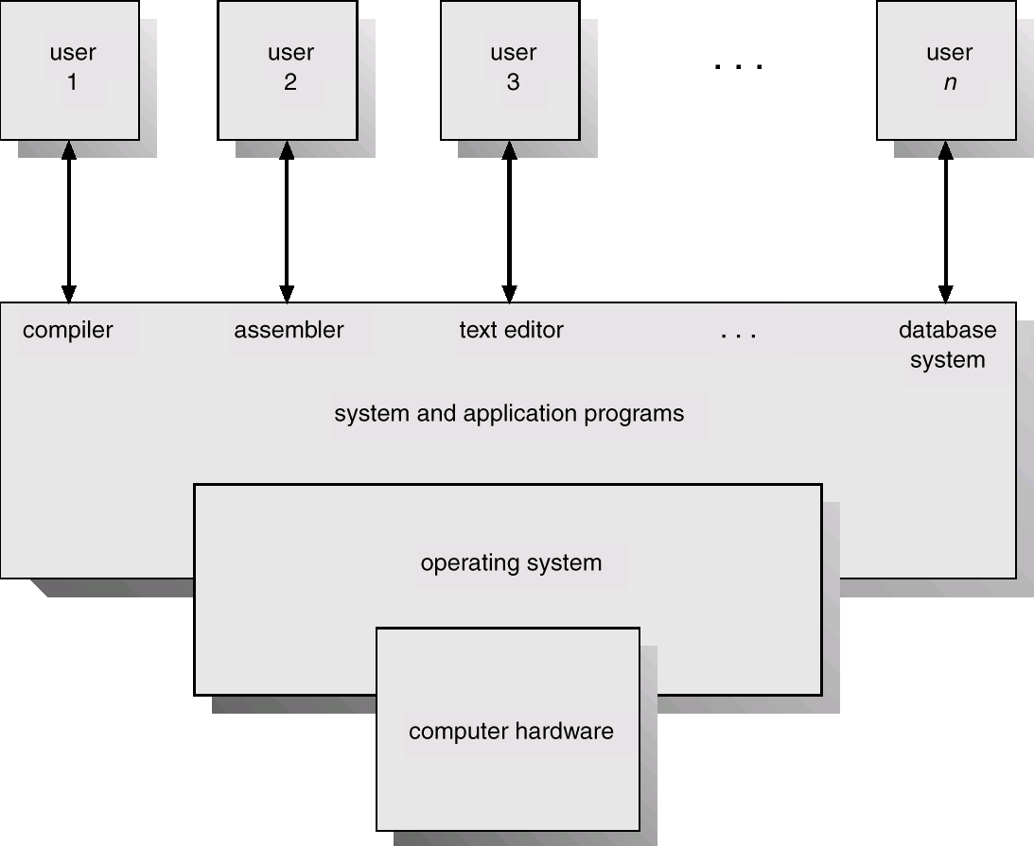
Abstract View of System Components

Slide 5
Function of Operating System
OS as Extended machine
Computer Architecture shows that computer is made up of chips and wires
We do not want to program on the bare metal
Virtual machine creates a hardware abstraction
Abstract machine can provide hardware independent interfaces
Increase portability
Allow greater protection
Implication is that it is much faster and easier to program with less errors

Slide 6
Function of Operating System
OS as resource manager
Coordination and control of limited resources such as memory, disk, network, etc
Deal with resource conflicts
Deal with resource fairness
Make access efficient as possible

Slide 7
Parts of an Operating System
No universal agreement on the topic, but most likely
Memory Management
IO Management
CPU Scheduling
IPC
MultiTasking/Multiprogramming
(On some Operating System, this functionality is provided by a single program known as the kernel)
What about?
File System
Multimedia Support
UI (X Windows, MSWin)
Internet Browser?
Why would extras be important

Slide 8
Evolution (History) of OS
First Generation: Punched cards
Second Generation: Transistors and batch systems.
Third Generation: (Integrated Circuits)
Spooling
Multiprogramming
Multitasking
Virtual Memory

Slide 9
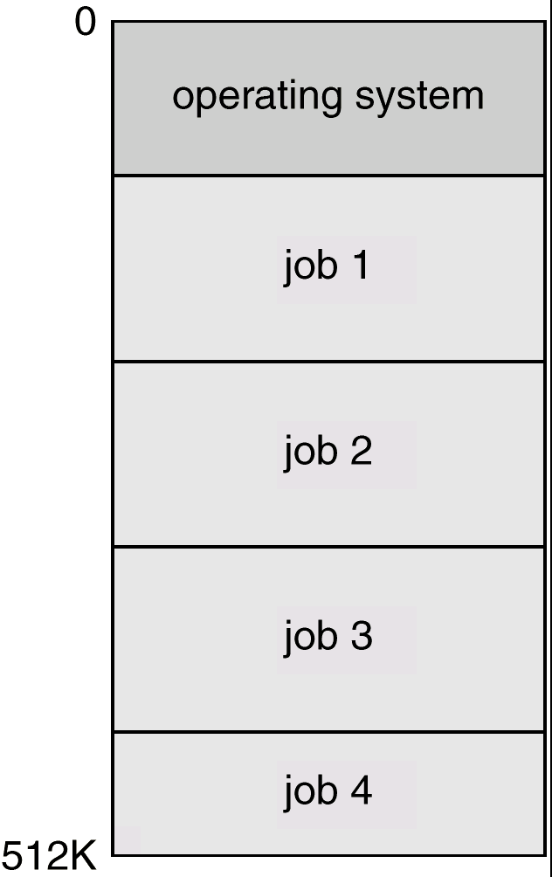
Multiprogramming
Memory partitioned into several pieces
CPU Starts a job
If the job is waiting for IO, the CPU can switch to another task

Slide 10
Multitasking (Time-sharing)
Extension of Multiprogramming
Need for user interactivity
Instead of switching jobs when waiting for IO, a timer causes jobs to switch
User interacts with computer via CRT and keyboard
Systems have to balance CPU utilization against response time
Better device management
Need for file system to allow user to access data and code
Need to provide user with an “interaction environment”

Slide 11
Virtual Memory
Programs can be larger than memory
Program loaded into memory as needed
Active program and data “swapped” to a disk until needed
Memory space treated uniformly

Slide 12
Why Operating Systems?
OS for CSE :
Real world OS is a software engineering problem
Design of the Virtual/Extended machine
Development of the Kernel
OS Usability, Human Factors for OS
OS for CSE:
New algorithms to help make OS better, more efficient
Hypothesis, experiments regarding OS approaches
OS for anyone else :
Help to understand better the parts of the OS and how to compare and contrast the various qualities of Operating Systems

